Slide 1
Process Synchronization

Slide 2
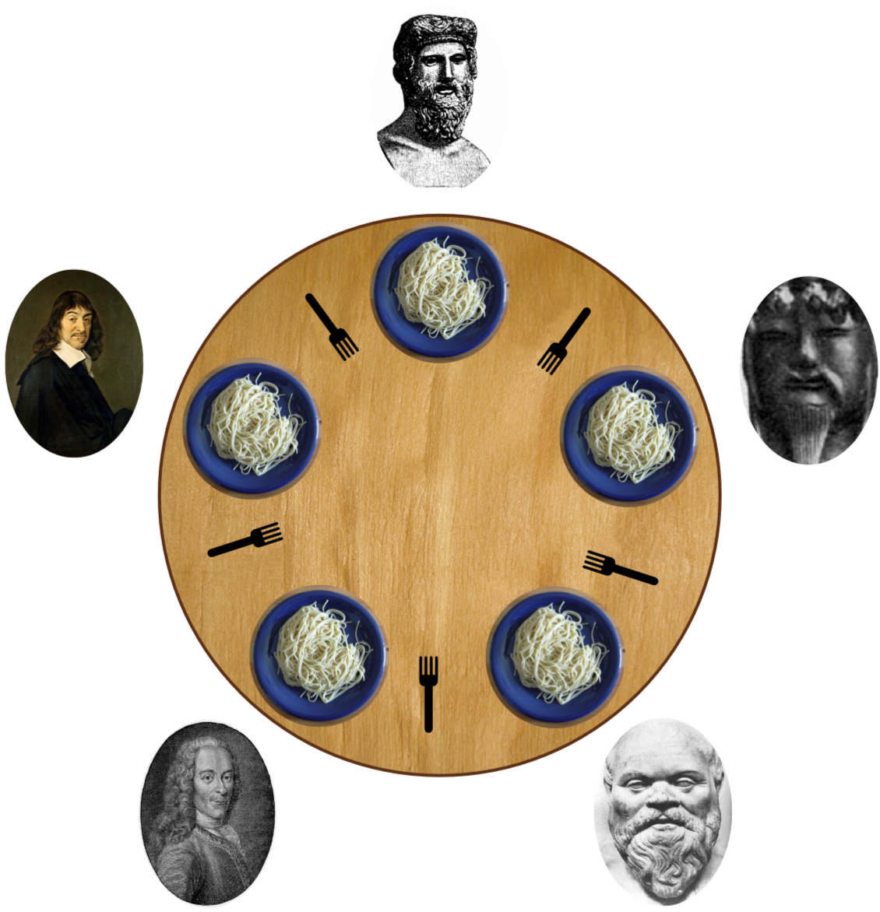
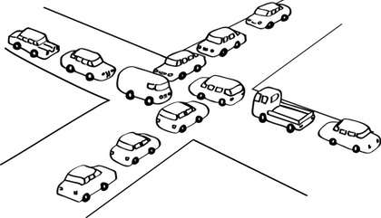
Concurrency

Slide 3

Process Synchronization

Slide 4
Normal Resource Usage

Slide 5
Concurrency Key Terms

Slide 6
Critical Section Problem
Consider system of n processes {p₀, p₁, … p_{n-1}}
Each process has critical section segment of code
Process may be changing common variables, updating table, writing file, etc
When one process in critical section, no other may be in its critical section
Critical section problem is to design protocol to solve this
Each process must ask permission to enter critical section in entry section, may follow critical section with exit section, then remainder section

Slide 7
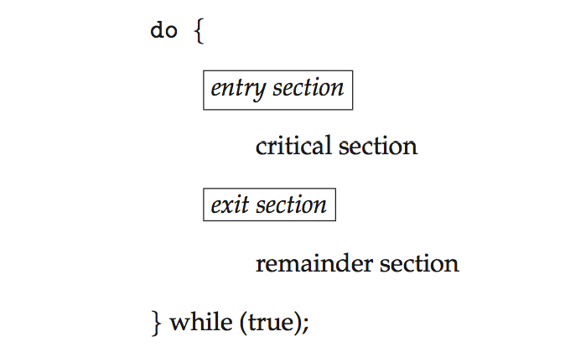
Critical Section
General structure of process P_{i}

Slide 8
Synchronization Hardware
Many systems provide hardware support for implementing the critical section code.
All solutions below based on idea of locking
Protecting critical regions via locks
Uniprocessors – could disable interrupts
Currently running code would execute without preemption
Generally too inefficient on multiprocessor systems
Operating systems using this not broadly scalable
Modern machines provide special atomic hardware instructions
Atomic = non-interruptible
Either test memory word and set value
Or swap contents of two memory words

Slide 9
Solution to Critical-section Problem Using Locks
do {
acquire lock
critical section
release lock
remainder section
} while (TRUE);

Slide 10
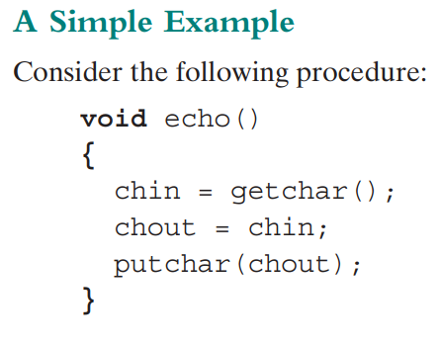



Principle of Concurrency
What happens if this person execute above code and then interrupted by another person

Slide 11

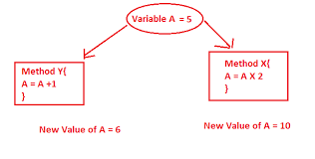
Race Condition

Slide 12
Race Condition

Slide 13
Race Condition
counter++ could be implemented as register1 = counter register1 = register1 + 1 counter = register1
counter-- could be implemented as register2 = counter register2 = register2 - 1 counter = register2
Consider this execution interleaving with “count = 5” initially:
S0: producer execute register1 = counter {register1 = 5} S1: producer execute register1 = register1 + 1 {register1 = 6} S2: consumer execute register2 = counter {register2 = 5} S3: consumer execute register2 = register2 – 1 {register2 = 4} S4: producer execute counter = register1 {counter = 6 } S5: consumer execute counter = register2 {counter = 4}

Slide 14
Process Interaction

Slide 15
Requirements For Mutual Exclusion

Slide 16
ME – Disabled Interrupt
It is costly as it is hardware support
Mutual Exclusion is guaranteed
High Priority Task may be denied
Will not work in case of multiple processors
Resources are shared – 3 process required same file
All remaining process stop – processors under utilization

Slide 17
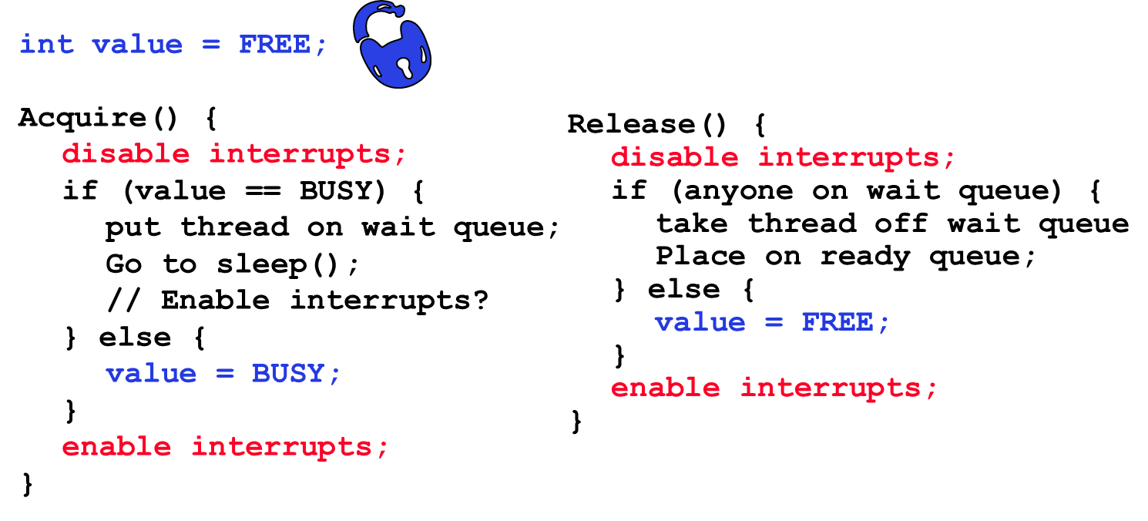
ME – Disabled Interrupt

Slide 18
ME – Machine Instructions
Compare and swap
Busy awaiting state / spin wait
Must not be interruptible

Slide 19
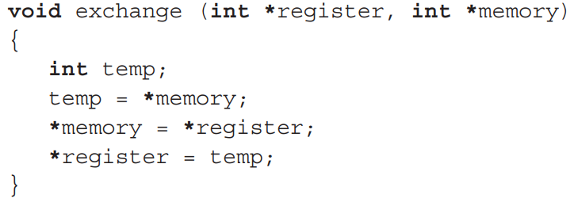
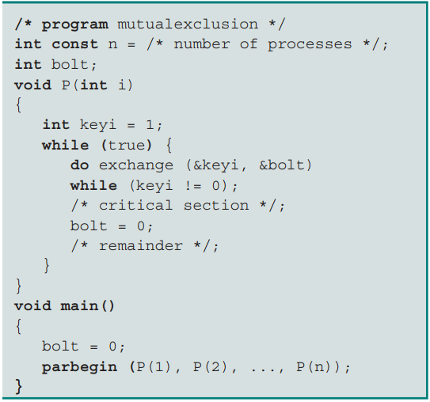
ME – Machine Instructions
Exchange instruction
XCHG in Assembly language
Busy awaiting state / spin wait
Must not be interruptible

Slide 20



Machine Instructions - Problems
Busy awaiting or spin wait
Starvation is Possible
Deadlock may occur
P1 execute machine instruction – change shared variable
Now interrupted by P2
P2 try to access same resources – go to wait (spin)
P1 never comes due to low priority than P2

Slide 21
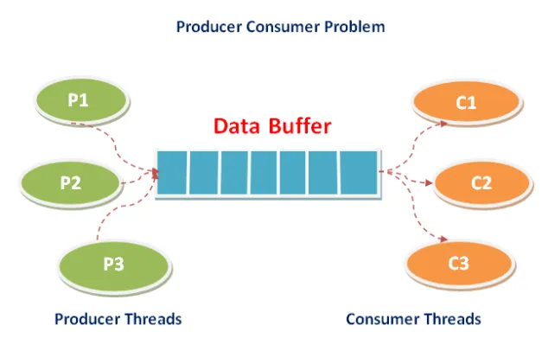
Critical Section Problems
Some Process(es) or thread(s) is/are producing data
Some Process(es) or thread(s) is/are consuming data
Producer must stop if buffer is full or consumer is consuming
Consumer must stop if buffer is empty or producer is producing

Slide 22

Critical Section Problems
Coke worker place cokes in vending machine
Customer take coke from vending machine
Vending machine can hold only 10 cokes
If machine is empty or worker is placing coke, customer should wait
If machine is full or costumer is taking coke, worker should wait

Slide 23
Producer
while (true) { /* produce an item in next produced */
while (counter == BUFFER_SIZE) ;
/* do nothing */
buffer[in] = next_produced;
in = (in + 1) % BUFFER_SIZE;
counter++;
}

Slide 24
Consumer
while (true) {
while (counter == 0)
; /* do nothing */
next_consumed = buffer[out];
out = (out + 1) % BUFFER_SIZE;
counter--;
/* consume the item in next consumed */
}

Slide 25
Producer-Consumer Solution
Semaphore fullSlots = 0; // Initially, no coke
Semaphore emptySlots = bufSize; // Initially, num empty slots
Semaphore mutex = 1; // No one using machine Producer(item) { emptySlots.P(); // Wait until space mutex.P(); // Wait until machine free Enqueue(item); mutex.V(); fullSlots.V();
// Tell consumers there is more coke }
Consumer() { fullSlots.P(); // Check if there’s a coke mutex.P(); // Wait until machine free item = Dequeue(); mutex.V(); emptySlots.V(); // tell producer need more return item; }

Slide 26
Critical Section Problems
Motivation: Consider a shared database
Two classes of users:
Readers – never modify database
Writers – read and modify database
Is using a single lock on the whole database sufficient?
Like to have many readers at the same time
Only one writer at a time

Slide 27
Reader Writer Solution
Correctness Constraints:
Readers can access database when no writers
Writers can access database when no readers or writers
Only one thread manipulates state variables at a time
Basic structure of a solution:
Reader() Wait until no writers Access data base Check out – wake up a waiting writer
Writer() Wait until no active readers or writers Access database Check out – wake up waiting readers or writer
State variables (Protected by a lock called “lock”):
int AR: Number of active readers; initially = 0
int WR: Number of waiting readers; initially = 0
int AW: Number of active writers; initially = 0
int WW: Number of waiting writers; initially = 0
Condition okToRead = NIL
Conditioin okToWrite = NIL

Slide 28
Reader Writer Solution - Reader
Reader() { // First check self into system lock.Acquire();
while ((AW + WW) > 0) { // Is it safe to read? WR++; // No. Writers exist okToRead.wait(&lock); // Sleep on cond var WR--; // No longer waiting }
AR++; // Now we are active! lock.release();
// Perform actual read-only access AccessDatabase(ReadOnly);
// Now, check out of system lock.Acquire(); AR--; // No longer active if (AR == 0 && WW > 0) // No other active readers okToWrite.signal(); // Wake up one writer lock.Release(); }

Slide 29
Reader Writer Solution - Writer
Writer() { // First check self into system lock.Acquire();
while ((AW + AR) > 0) { // Is it safe to write? WW++; // No. Active users exist okToWrite.wait(&lock); // Sleep on cond var WW--; // No longer waiting }
AW++; // Now we are active! lock.release();
// Perform actual read/write access AccessDatabase(ReadWrite);
// Now, check out of system lock.Acquire(); AW--; // No longer active if (WW > 0){ // Give priority to writers okToWrite.signal(); // Wake up one writer } else if (WR > 0) { // Otherwise, wake reader okToRead.broadcast(); // Wake all readers } lock.Release(); }

Slide 30
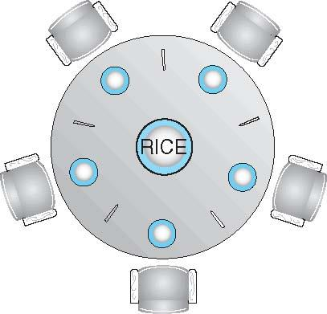
Dining-Philosophers Problem
Philosophers spend their lives alternating thinking and eating
Don’t interact with their neighbors, occasionally try to pick up 2 chopsticks (one at a time) to eat from bowl
Need both to eat, then release both when done
In the case of 5 philosophers
Shared data
Bowl of rice (data set)
Semaphore chopstick [5] initialized to 1

Slide 31
Mutex Locks
Previous solutions are complicated and generally inaccessible to application programmers
OS designers build software tools to solve critical section problem
Simplest is mutex lock
Protect a critical section by first acquire() a lock then release() the lock
Boolean variable indicating if lock is available or not
Calls to acquire() and release() must be atomic
Usually implemented via hardware atomic instructions
But this solution requires busy waiting
This lock therefore called a spinlock

Slide 32
acquire() and release()
acquire() { while (!available)
; /* busy wait */
available = false;;
}
release() {
available = true;
}
do {
acquire lock
critical section
release lock
remainder section
} while (true);

Slide 33
Semaphore
Synchronization tool that provides more sophisticated ways (than Mutex locks) for process to synchronize their activities.
Semaphore S – integer variable
Can only be accessed via two indivisible (atomic) operations
wait() and signal()
Originally called P() and V()
Definition of the wait() operation
wait(S) {
while (S <= 0)
; // busy wait
S--;
}
Definition of the signal() operation
signal(S) {
S++;
take one of the waiting process from queue
}

Slide 34
Semaphore Usage
Counting semaphore – integer value can range over an unrestricted domain
Binary semaphore – integer value can range only between 0 and 1
Same as a mutex lock
Can solve various synchronization problems
Consider P₁ and P₂ that require S₁ to happen before S₂
Create a semaphore “synch” initialized to 0
P1:
S₁;
signal(synch);
P2:
wait(synch);
S₂;
Can implement a counting semaphore S as a binary semaphore

Slide 35
Semaphore Implementation
Must guarantee that no two processes can execute the wait() and signal() on the same semaphore at the same time
Thus, the implementation becomes the critical section problem where the wait and signal code are placed in the critical section
Could now have busy waiting in critical section implementation
But implementation code is short
Little busy waiting if critical section rarely occupied
Note that applications may spend lots of time in critical sections and therefore this is not a good solution

Slide 36
Semaphore Implementation with no Busy waiting
With each semaphore there is an associated waiting queue
Each entry in a waiting queue has two data items:
value (of type integer)
pointer to next record in the list
Two operations:
block – place the process invoking the operation on the appropriate waiting queue
wakeup – remove one of processes in the waiting queue and place it in the ready queue
typedef struct{
int value;
struct process *list;
} semaphore;

Slide 37
Implementation with no Busy waiting (Cont.)
wait(semaphore *S) {
S->value--;
if (S->value < 0) { add this process to S->list;
block();
}
}
signal(semaphore *S) {
S->value++;
if (S->value <= 0) { remove a process P from S->list;
wakeup(P);
}
}

Slide 38
Deadlock and Starvation
Deadlock – two or more processes are waiting indefinitely for an event that can be caused by only one of the waiting processes
Let S and Q be two semaphores initialized to 1
P₀ P₁
wait(S); wait(Q);
wait(Q); wait(S);
... ...
signal(S); signal(Q);
signal(Q); signal(S);
Starvation – indefinite blocking
A process may never be removed from the semaphore queue in which it is suspended
Priority Inversion – Scheduling problem when lower-priority process holds a lock needed by higher-priority process
Solved via priority-inheritance protocol

Slide 39
Classical Problems of Synchronization
Classical problems used to test newly-proposed synchronization schemes
Bounded-Buffer Problem
Readers and Writers Problem
Dining-Philosophers Problem

Slide 40
Bounded-Buffer Problem
n buffers, each can hold one item
Semaphore mutex initialized to the value 1
Semaphore full initialized to the value 0
Semaphore empty initialized to the value n

Slide 41
Bounded Buffer Problem (Cont.)
The structure of the producer process
do {
... /* produce an item in next_produced */
...
wait(empty);
wait(mutex);
... /* add next produced to the buffer */
...
signal(mutex);
signal(full);
} while (true);

Slide 42
Bounded Buffer Problem (Cont.)
The structure of the consumer process
Do {
wait(full);
wait(mutex);
... /* remove an item from buffer to next_consumed */
...
signal(mutex);
signal(empty);
... /* consume the item in next consumed */
... } while (true);

Slide 43
Readers-Writers Problem
A data set is shared among a number of concurrent processes
Readers – only read the data set; they do not perform any updates
Writers – can both read and write
Problem – allow multiple readers to read at the same time
Only one single writer can access the shared data at the same time
Several variations of how readers and writers are considered – all involve some form of priorities
Shared Data
Data set
Semaphore rw_mutex initialized to 1
Semaphore mutex initialized to 1
Integer read_count initialized to 0

Slide 44
Readers-Writers Problem (Cont.)
The structure of a writer process
do { wait(rw_mutex);
... /* writing is performed */
...
signal(rw_mutex);
} while (true);

Slide 45
Readers-Writers Problem (Cont.)
The structure of a reader process
do { wait(mutex); read_count++; if (read_count == 1)
wait(rw_mutex);
signal(mutex);
... /* reading is performed */
...
wait(mutex); read count--; if (read_count == 0)
signal(rw_mutex);
signal(mutex);
} while (true);

Slide 46
Readers-Writers Problem Variations
First variation – no reader kept waiting unless writer has permission to use shared object
Second variation – once writer is ready, it performs the write ASAP
Both may have starvation leading to even more variations
Problem is solved on some systems by kernel providing reader-writer locks

Slide 47
Dining-Philosophers Problem Algorithm
The structure of Philosopher i:
do {
wait (chopstick[i] );
wait (chopStick[ (i + 1) % 5] );
// eat
signal (chopstick[i] );
signal (chopstick[ (i + 1) % 5] );
// think
} while (TRUE);
What is the problem with this algorithm?

Slide 48
Dining-Philosophers Problem Algorithm (Cont.)
Deadlock handling
Allow at most 4 philosophers to be sitting simultaneously at the table.
Allow a philosopher to pick up the forks only if both are available (picking must be done in a critical section.
Use an asymmetric solution -- an odd-numbered philosopher picks up first the left chopstick and then the right chopstick. Even-numbered philosopher picks up first the right chopstick and then the left chopstick.

Slide 49
Problems with Semaphores
Incorrect use of semaphore operations:
signal (mutex) …. wait (mutex)
wait (mutex) … wait (mutex)
Omitting of wait (mutex) or signal (mutex) (or both)
Deadlock and starvation are possible.

Slide 50
Linux Synchronization
Linux:
Prior to kernel Version 2.6, disables interrupts to implement short critical sections
Version 2.6 and later, fully preemptive
Linux provides:
Semaphores
atomic integers
spinlocks
reader-writer versions of both
On single-cpu system, spinlocks replaced by enabling and disabling kernel preemption

Slide 51
Pthreads Synchronization
Pthreads API is OS-independent
It provides:
mutex locks
condition variable
Non-portable extensions include:
read-write locks
spinlocks

Slide 52
OpenMP Synchronization
OpenMP is a set of compiler directives and API that support parallel progamming.
void update(int value)
{
#pragma omp critical
{
count += value
}
}
The code contained within the #pragma omp critical directive is treated as a critical section and performed atomically.

